Slide 1


Slide 2
Code Refactoring
&
Code Smell

Slide 3
What is refactoring?

Slide 4

What is Refactoring?
“Refactoring is a change made to the internal structure of software to make it easier to understand and cheaper to modify without changing its observable behavior.”
- Martin Fowler
Is it just cleaning up code?
The technique of cleaning up code in more organized and controlled

Slide 5


The Two Hats
Two distinct activities
adding functions
refactoring
These two activities should NOT take place at the same time

Slide 6
Goals
Prevent code quality reduction
Make code clear
Help to find bugs
Help to program faster

Slide 7

When to Refactor
The Rule of Three
Three strikes and you refactor
You do something the first time
You do similar thing again with regret
On the third time – start refactoring
It states that two instances of similar code don’t require refactoring, but when similar code is used three times, it should be extracted.

Slide 8
When to Refactor
When adding new functionality
understanding the code
prepare code for adding new functionality
When fixing a bug
error is a sign for refactoring
Code reviews

Slide 9


Problems with Refactoring
Database
difficult to change since tightly coupled to scheme
existing data migration
Changing Interface
deprecate old interface
Notes:
depreciate = diminish in value over a period of time.

Slide 10


When You Shouldn’t Refactor
Low code quality
easier rewrite than refactor
code should work correctly before refactoring
Deadline is too close
postpone refactoring = technical debt
Notes:
technical debt is the idea that certain necessary work gets delayed during the development of a software project in order to hit a deliverable or deadline

Slide 11
Smelling Code
Signs of low quality code?

Slide 12
Code Smell
Code smells are indicators of problems that can be addressed during refactoring.
Code smells are easy to spot and fix, but they may be just symptoms of a deeper problem with code.

Slide 13
Code Duplication
Two code fragments look almost identical.
Duplication usually occurs when multiple programmers are working on different parts of the same program at the same time.
Reason
Since they’re working on different tasks, they may be unaware their colleague has already written similar code that could be repurposed for their own needs.

Slide 14
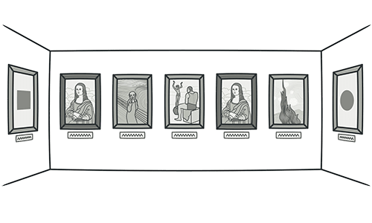
Code Duplication

Slide 15
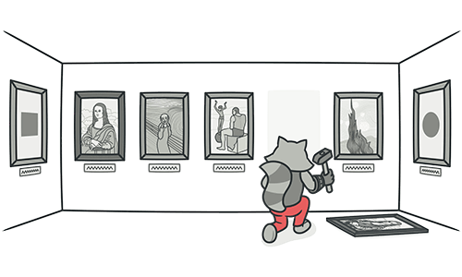
Code Duplication
Treatment:
If the same code is found in two or more methods in the same class: use Extract Method and place calls for the new method in both places.
The Extract Method refactoring lets you take a code fragment that can be grouped, move it into a separated method, and replace the old code with a call to the method.

Slide 16
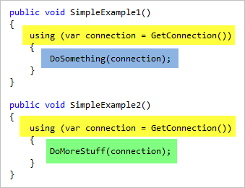
Code Duplication Example
Same Functionality
But Code is Duplicated
Notes:
The void type, in several programming, is the type for the result of a function that returns normally, but does not provide a result value to its caller. Usually such functions are called for their side effects, such as performing some task or writing to their output parameters

Slide 17
Long Method
A method contains too many lines of code.
Generally, any method longer than ten lines should make you start asking questions.
Reason:
Something is always being added to a method but nothing is ever taken out.
Since it’s easier to write code than to read it, this “smell” remains unnoticed until the method turns into an ugly, oversized beast.

Slide 18
Long Method
Treatment:
As a rule of thumb, if you feel the need to comment on something inside a method, you should take this code and put it in a new method.
Even a single line can and should be split off into a separate method, if it requires explanations.
Notes:
A method in object-oriented programming (OOP) is a procedure associated with a message and an object.

Slide 19
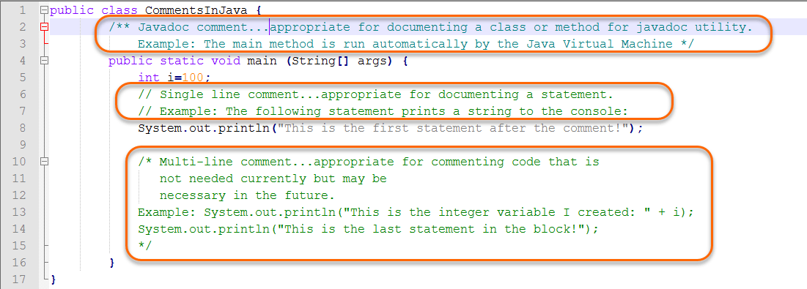
Long Method Example

Slide 20
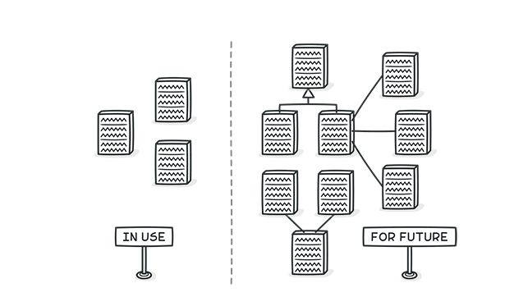
Speculative Generality
We need this functionality someday
Sometimes code is created “just in case” to support anticipated future features that never get implemented.
As a result, code becomes hard to understand and support.
Example
Notes:
speculative = based on a guess and not on information

Slide 21
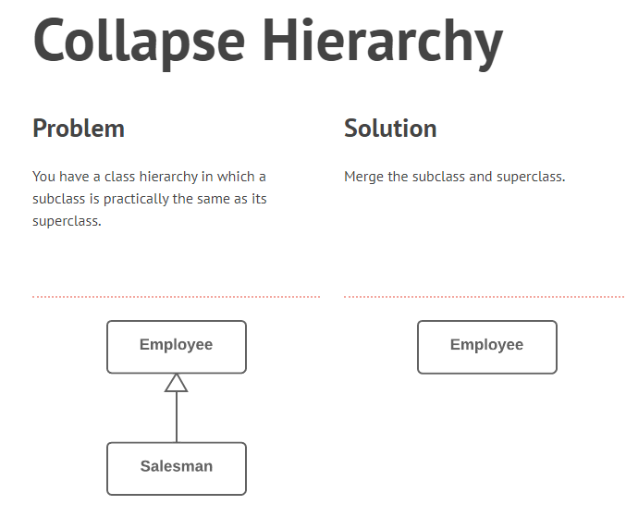

Slide 22
Collapse Hierarchy Example

Slide 23
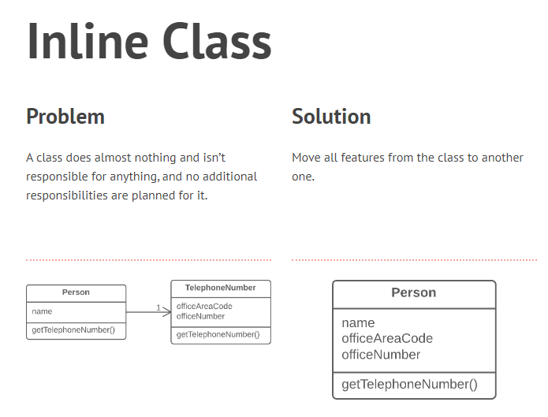

Slide 24
Inline Class Example
Notes:
Class name, attributes, operation or method

Slide 25
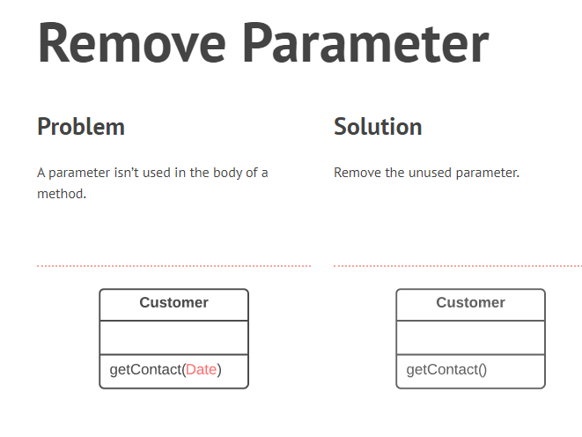
Notes:
Parameters identify values that are passed into a function

Slide 26
Remove Parameter Example
Every parameter in a method call forces the programmer reading it to figure out what information is found in this parameter.
And if a parameter is entirely unused in the method body, this should be removed.

Slide 27
Inappropriate Intimacy
Too closely coupled
Keep a close eye on classes that spend too much time together.
Good classes should know as little about each other as possible.
Such classes are easier to maintain and reuse.
Notes:
intimacy meaning= close familiarity

